Slide 1

Hanoi University of Science and Technology
IT3110E 147839 Object-oriented Programming
ESTATE
MANAGEMENT
WEBSITE

Slide 2
PREPARED BY
Tran Anh Dung 20226031
Nguyen Dinh An 20226007 Nguyen Huu Hoang Hai Anh 20226010 Le Ngoc Quang Hung 20226069

Slide 3
01
INTRODUCTION

Slide 4
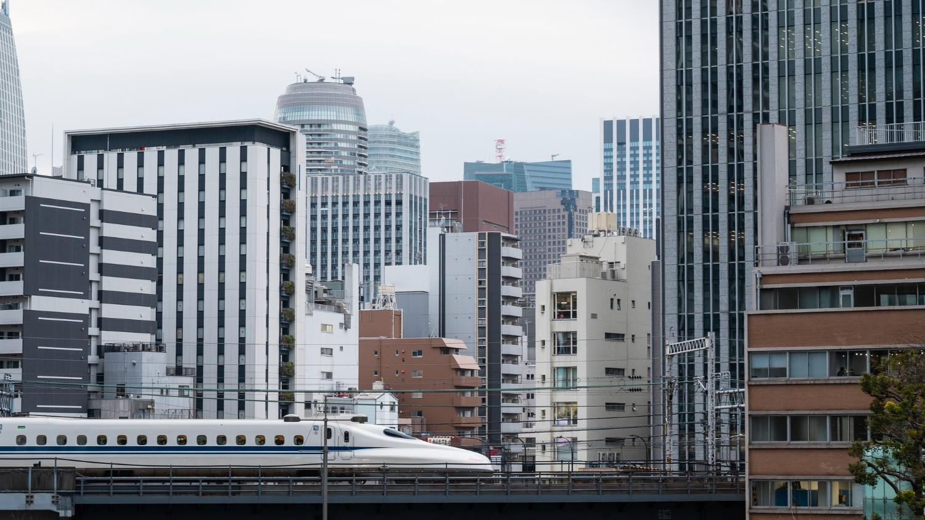
1.1 Background
Estate management systems are crucial for handling different property types, streamlining operations such as property listings, tenant management, maintenance requests, and financial transactions.
Digital transformation emphasizes the necessity of a strong back-end to manage complex workflows and extensive datasets.

Slide 5
1.2 Objective
Implement key features for an estate management system:
Staff management (registration, authentication, role-based access control)
Property management (listing, updating, deleting properties)
Exclude front-end implementation, real-time data processing, and advanced analytics (potential future extensions).
Develop a back-end system for an estate management website using modern Java-based frameworks.
Provide a comprehensive API to support functionalities such as property listing, user authentication, role-based access control, and data persistence.
1.3 Scope

Slide 6
TECHNOLOGY USED
Srping Boot
Srping MVC
Spring Data JPA
Spring security
For creating a stand-alone, production-grade Spring-based application with minimal configuration.
For implementing security features such as authentication and authorization
For data persistence and ORM capabilities, simplifying database interactions
For handling web requests and building RESTful APIs.

Slide 7
02
Use Case Diagram

Slide 8
Use Case Diagram

Slide 9
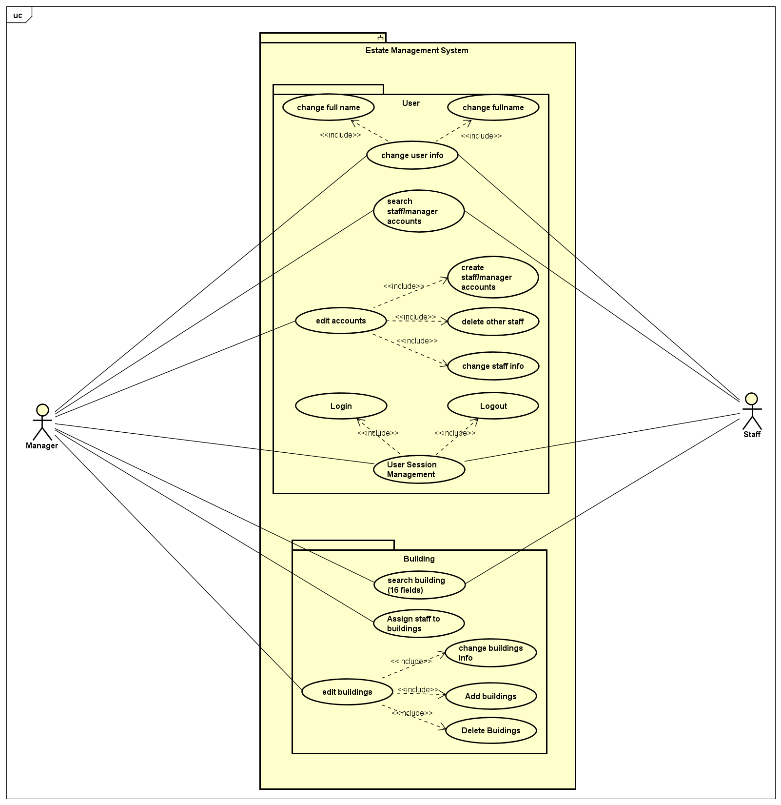
Use Case Diagram

Slide 10
03
Design

Slide 11
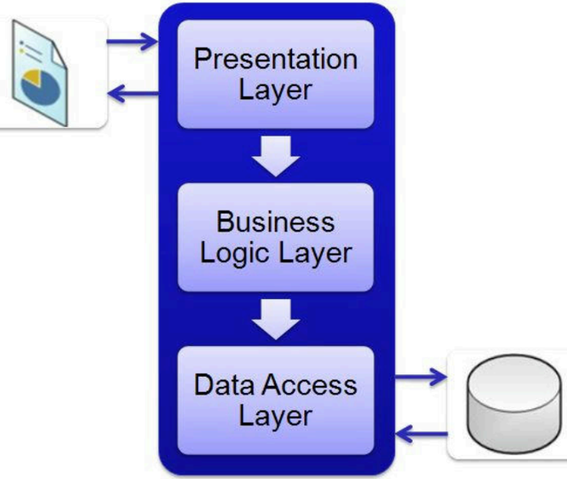
Architecture
Three-layer architecture:
Presentation Layer.
Business Logic Layer.
Data Access Layer.
Promotes separation of concerns, making the system easier to maintain and extend.

Slide 12
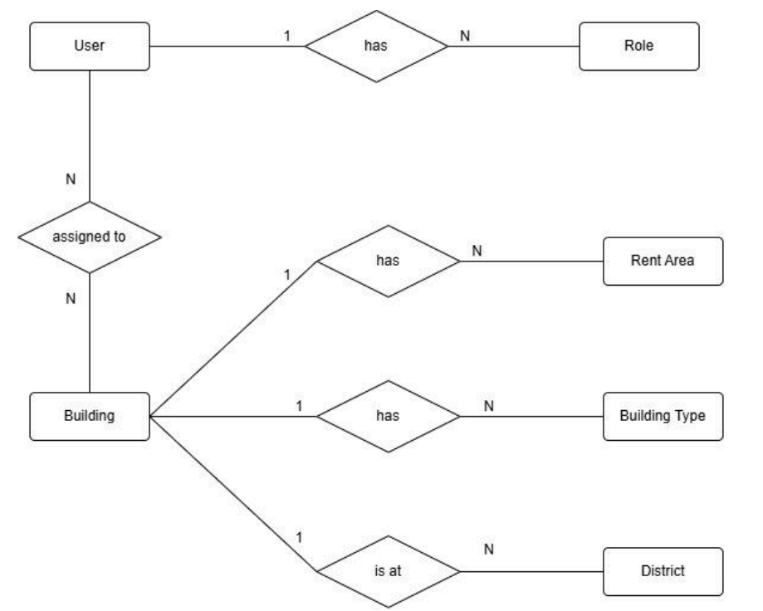
Entity-Relationship Diagram
Though not exactly within the scope of this project, the classes that hold data are derived from the Entity-Relationship Diagram and must be discussed. The main entities in the system are: • User (either with the role of Staff or Manager) • Building (also referred to as Property)

Slide 13
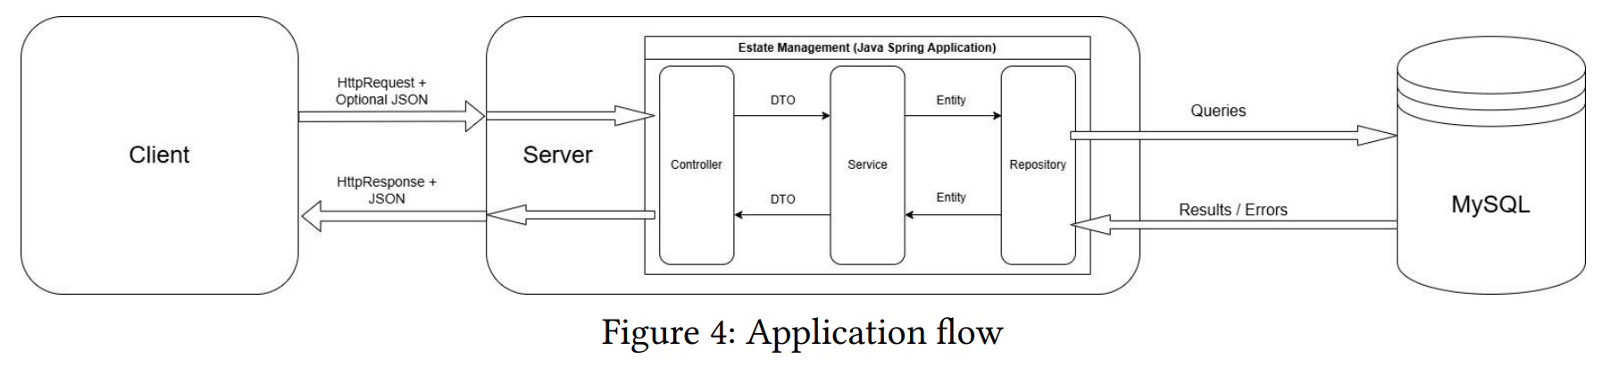
Application flow
Presentation Layer = Controller, Business Logic Layer = Service, Data Access Layer = Repository

Slide 14
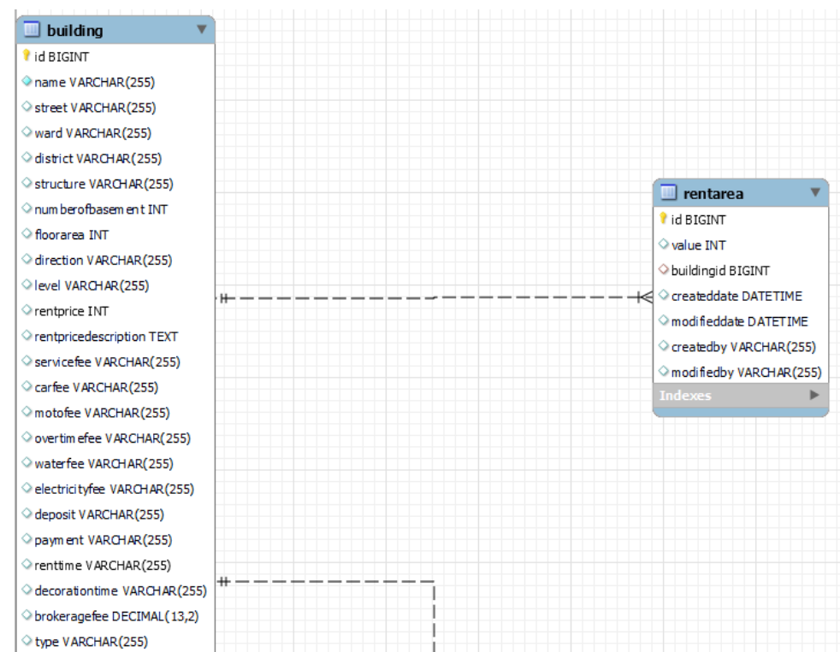
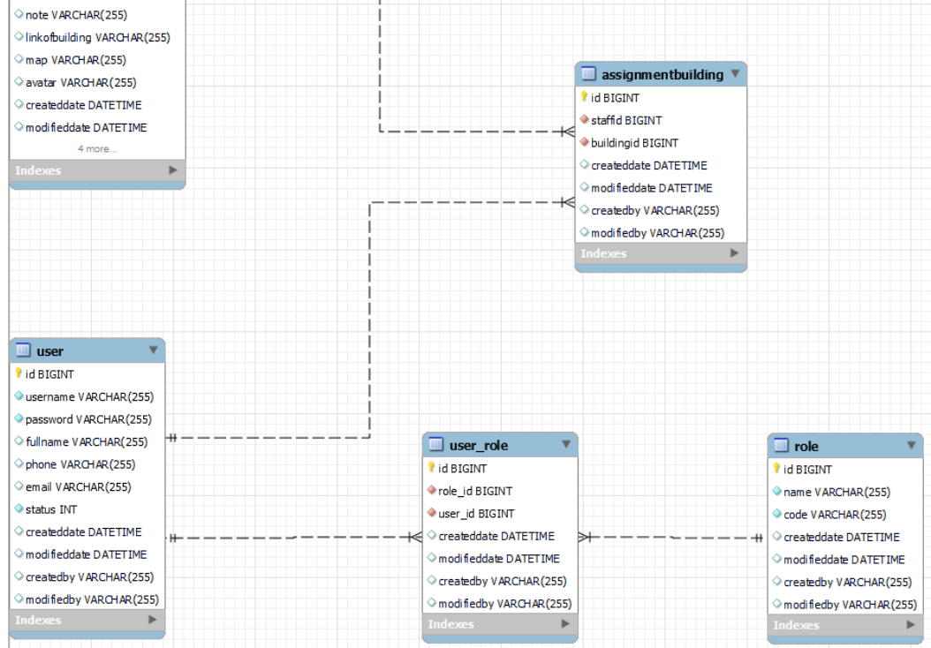
Data - Entity
The Entity-Relationship Diagram is converted to a database schema

Slide 15
Entity Class

Slide 16
DTO Classes

Slide 17
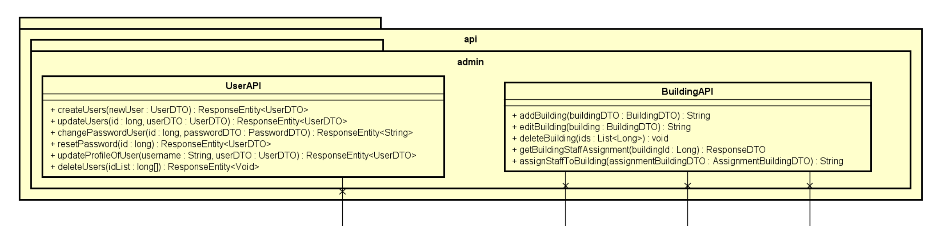
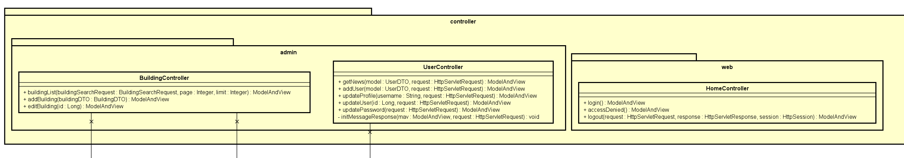
Presentation Layer

Slide 18
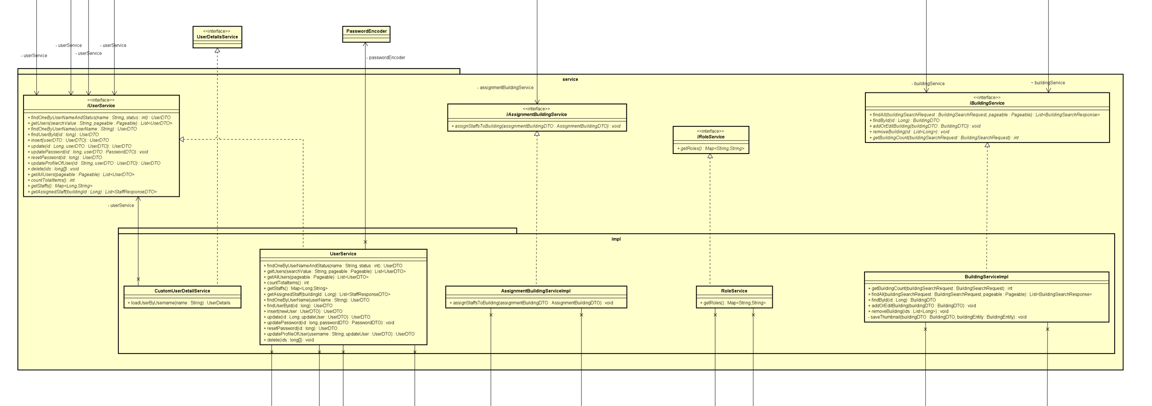
Business Logic Layer
Presentation Layer = Controller, Business Logic Layer = Service, Data Access Layer = Repository

Slide 19
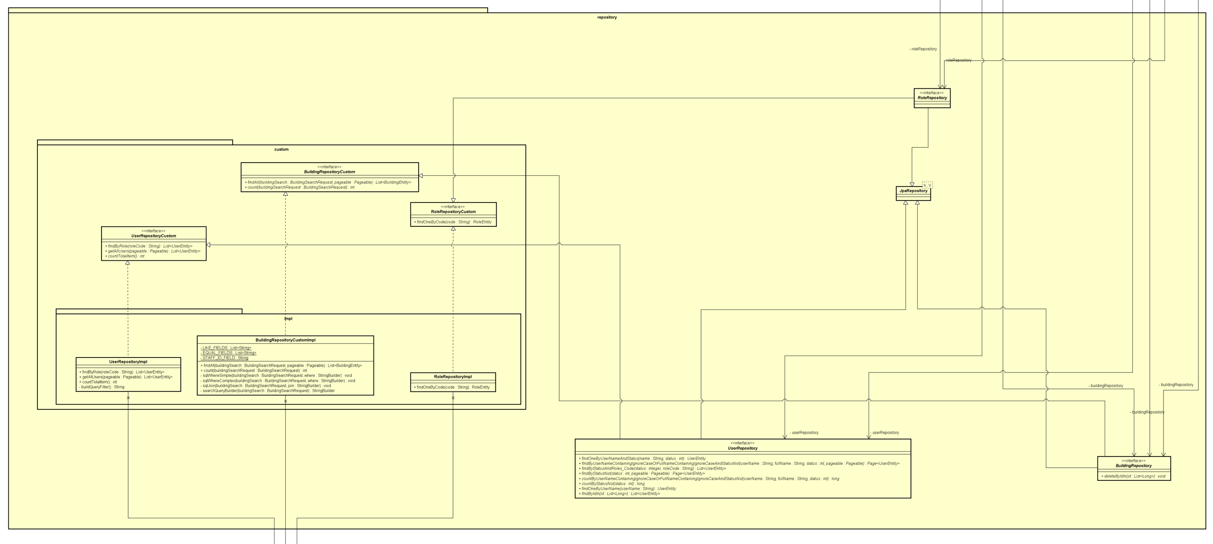
Data Access Layer

Slide 20
Others

Slide 21
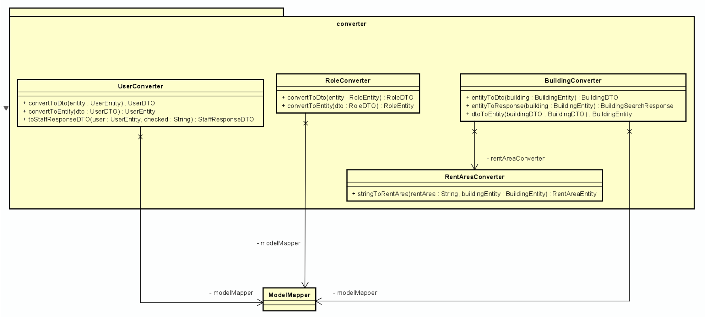
Converters
Presentation Layer = Controller, Business Logic Layer = Service, Data Access Layer = Repository

Slide 22
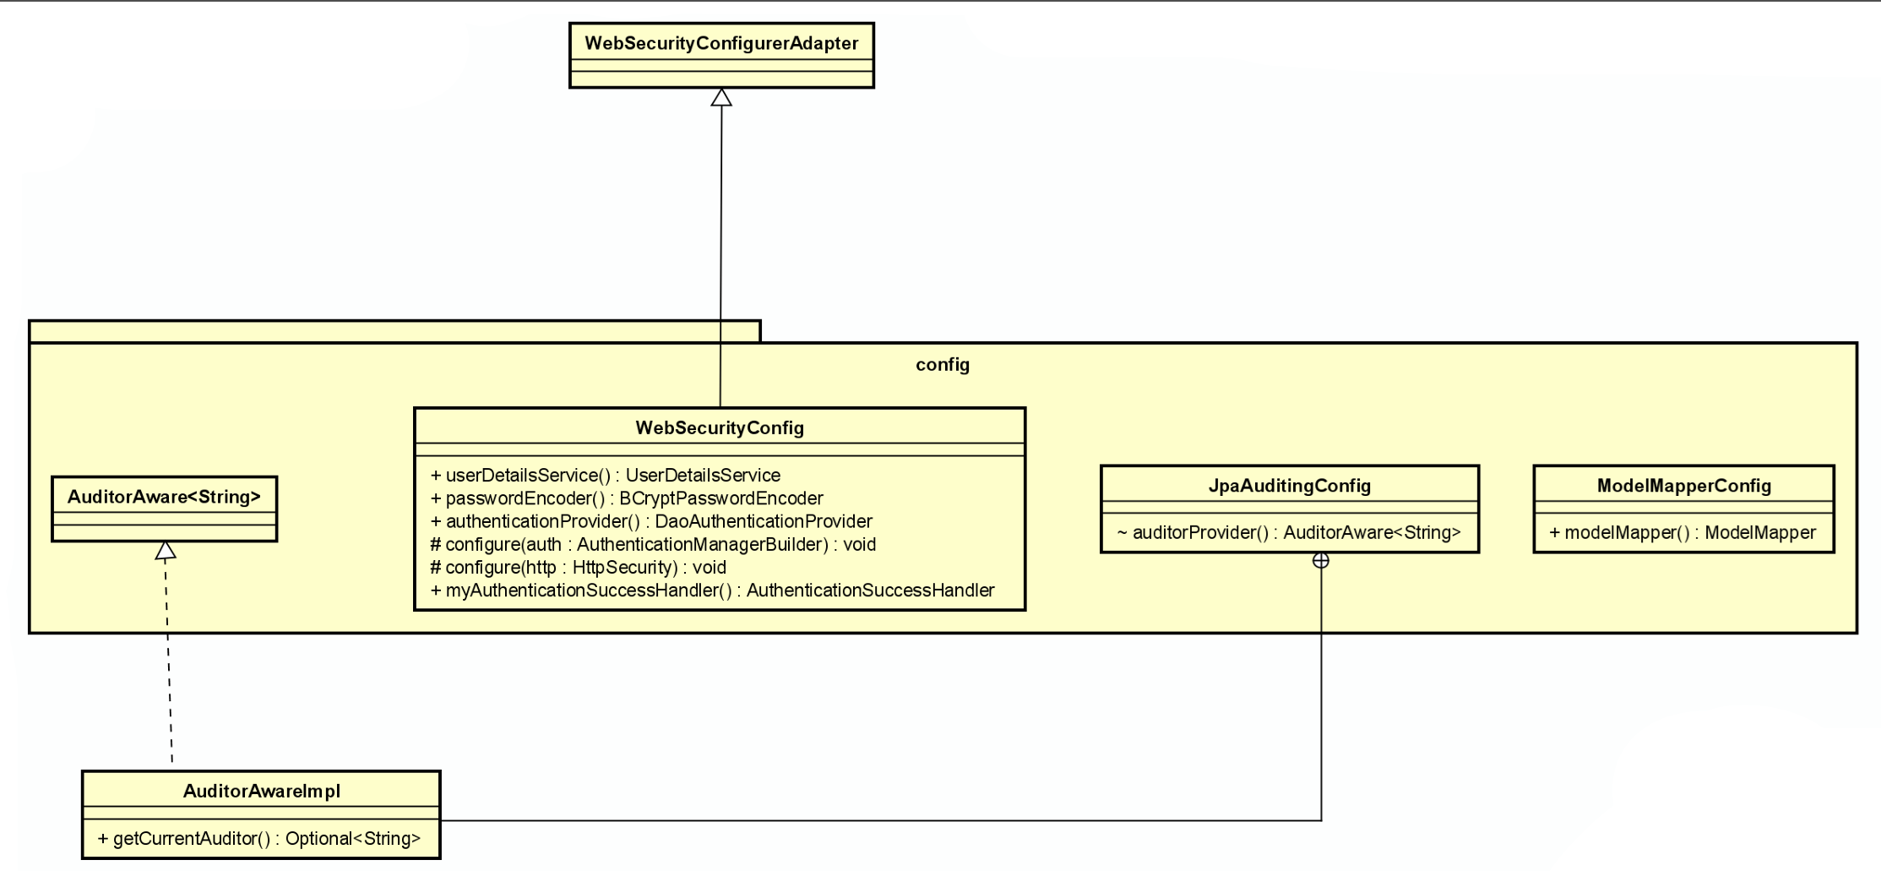
Configurations

Slide 23
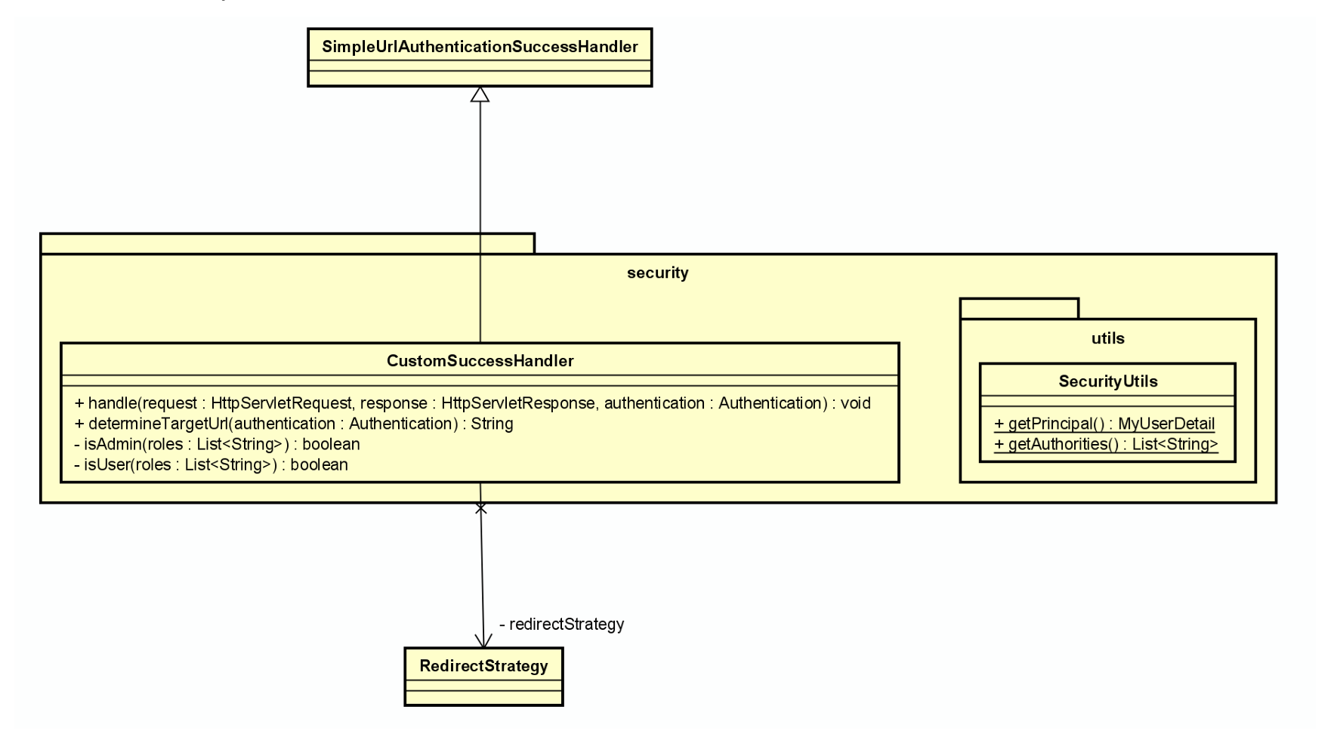
Web Security
Presentation Layer = Controller, Business Logic Layer = Service, Data Access Layer = Repository

Slide 24
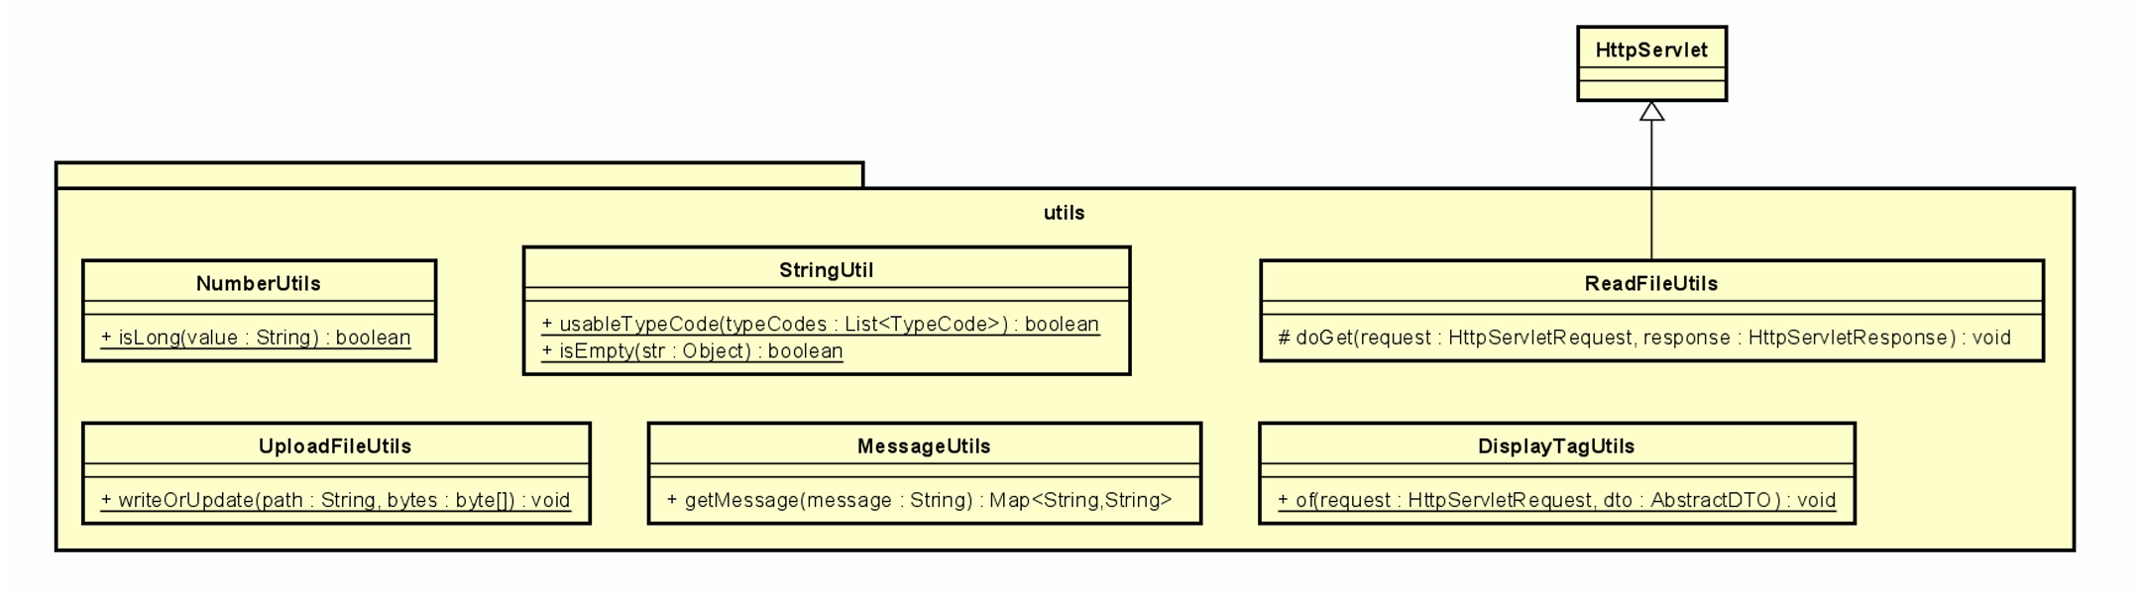
Utilities

Slide 25
04
Team Member Assignment

Slide 26
Nguyen Huu Hoang Hai Anh: Use Case Diagram, Enums Class Diagram, Presentation Layer Diagram and their Java code.
• Tran Anh Dung: Business Logic Layer Diagram, DTO Class Diagram and their Java code, also organize team members’ code, writing the report and user manual
• Nguyen Dinh An: Database schema, Data Access Layer Diagram, Entity Diagram and their Java code.
• Le Ngoc Quang Hung: Configuration Diagram, Exception Diagram, Utility Diagram, Converter Diagram, Web Security Diagram and their code.

Slide 27
Here are three important ideas
Mercury
Venus
Mars
Mercury is the closest planet to the Sun and the smallest of them all
Venus has a beautiful name and is the second planet from the Sun
Despite being red, Mars is actually a cold place. It’s full of iron oxide dust

Slide 28
Divide the content in four ideas
Mars
Venus
Mars is actually a very cold place
Venus has extremely high temperatures
Jupiter
Saturn
Jupiter is the biggest planet of them all
Saturn is a gas giant and has several rings

Slide 29
You can use five columns
Mars
Venus
Jupiter
Mars is actually a very cold place
Venus has extremely high temperatures
Jupiter is the biggest planet of them all
Mercury
Saturn
Mercury is the closest planet to the Sun
Saturn is a gas giant with several rings

Slide 30
Reviewing concepts is a good idea
Mars
Venus
Neptune
Mars is actually a very cold place
Venus has extremely high temperatures
Neptune is the farthest planet from the Sun
Mercury
Saturn
Jupiter
Mercury is the closest planet to the Sun
Saturn is a gas giant with several rings
Jupiter is the biggest planet of them all

Slide 31
Awesome words

Slide 32
—Someone Famous
“This is a quote, words full of wisdom that someone important said and can make the reader get inspired.”

Slide 33
This is a scheme
Sun
Venus
Mars
Mercury
Earth
Jupiter
Saturn
Mercury is the closest planet to the Sun
Earth is the planet on which we all live
Venus is the second planet from the Sun
Saturn is a gas giant and has several rings

Slide 34
You can use an infographic
01
Mars
02
Venus
03
Jupiter
Mars is actually a very cold place
Venus has a beautiful name
Jupiter doesn’t have a solid surface
04
Earth
05
Neptune
06
Saturn
Earth is the planet on which we all live
Neptune is very far away from the Sun
Saturn was named after a Roman god

Slide 35
4,498,300,000
Big numbers catch your audience’s attention

Slide 36
9h 55m 23s
333,000
386,000 km
Jupiter’s rotation period
The Sun’s mass compared to Earth’s
Distance between Earth and the Moon

Slide 37
Let’s use some percentages
15%
25%
60%
Mercury
Venus
Mars
Mercury is the closest planet to the Sun and the smallest of them all
Venus has a beautiful name and is the second planet from the Sun
Despite being red, Mars is actually a cold place. It’s full of iron oxide dust

Slide 38
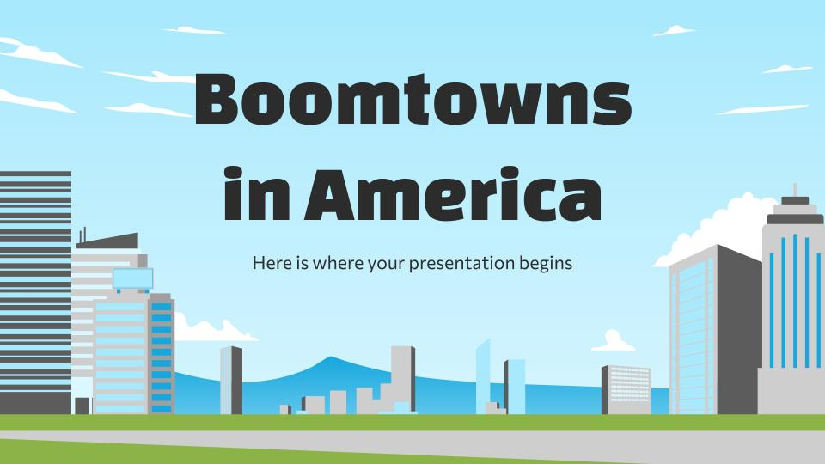
Computer mockup
You can replace the image on the screen with your own work. Just right-click on it and select “Replace image”

Slide 39
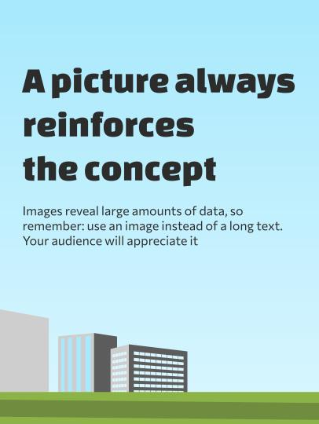
Tablet mockup
You can replace the image on the screen with your own work. Just right-click on it and select “Replace image”

Slide 40
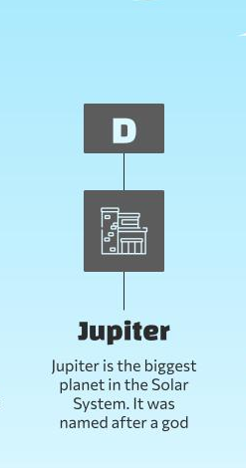
Phone mockup
You can replace the image on the screen with your own work. Just right-click on it and select “Replace image”

Slide 41
This is a map
Idaho
Venus is the second planet from the Sun
California
Mercury is the closest planet to the Sun
Florida
Despite being red, Mars is a very cold place

Slide 42
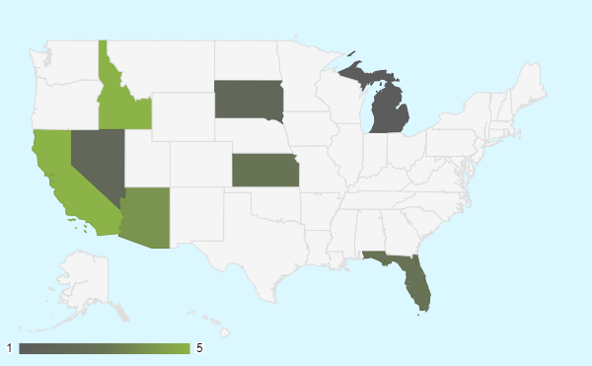
This is other map
Maximum
Minimum
Venus has very high temperatures
Despite being red, Mars is very cold
Venus has a beautiful name and is the second planet from the Sun. It’s terribly hot, even hotter than Mercury
Follow the link in the graph to modify its data and then paste the new one here. For more info, click here

Slide 43
A timeline always works well
Venus is the second planet from the Sun. It’s terribly hot
Despite being red, Mars is a very cold place. It’s full of iron oxide dust
Mercury is the closest planet to the Sun and the smallest of them all
Jupiter is a gas giant and the biggest planet in the Solar System

Slide 44
This is an infographic
Mars
Mars is actually a very cold place
Mercury
Mercury is the closest planet to the Sun
Venus
Venus has extremely high temperatures
Saturn
Saturn is a gas giant and has several rings

Slide 45
Maybe you need a table
 | Mercury | Mars | Venus | Saturn
Mercury is very small | 345 | 655 | 245 | 942
Mars is a cold planet | 635 | 533 | 654 | 407
Venus is a hot planet | 486 | 732 | 632 | 226
Saturn is a gas giant | 267 | 246 | 853 | 246
Jupiter is a big planet | 632 | 642 | 987 | 371

Slide 46
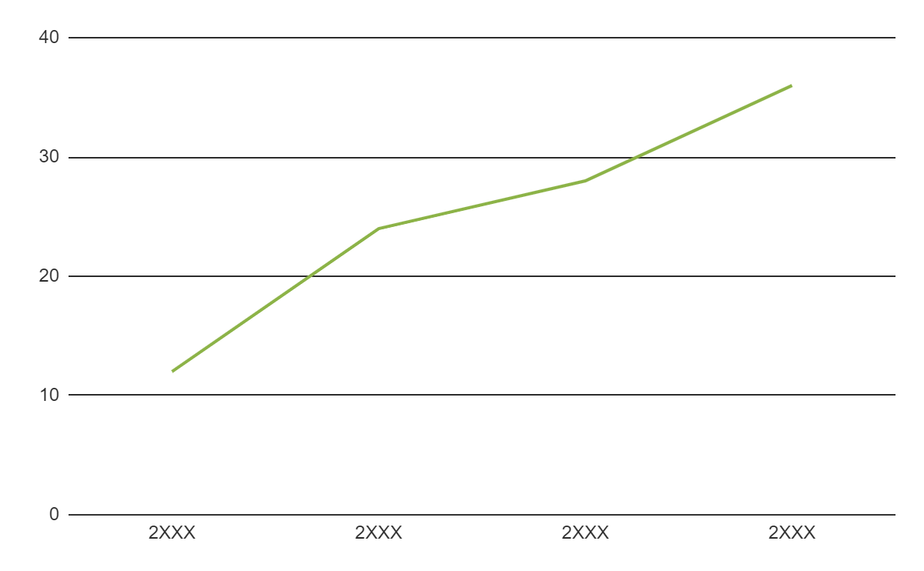
You can use this graph
Venus
Venus has very high temperatures
Venus has a beautiful name and is the second planet from the Sun. It’s terribly hot, even hotter than Mercury
Follow the link in the graph to modify its data and then paste the new one here. For more info, click here

Slide 47




Our team
John Doe
Evan Lee
You can speak a bit about this person here
You can speak a bit about this person here
Sofia Hill
Kaliyah Harris
You can speak a bit about this person here
You can speak a bit about this person here

Slide 48
Famous boomtowns
Boomtown | Location | Time period | Industry
San Francisco | California | 1848-1855 | Gold Rush
Tombstone | Arizona | 1877-1890 | Silver mining
Dodge City | Kansas | 1872-1886 | Cattle trade
Deadwood | South Dakota | 1876-1879 | Gold mining
Butte | Montana | 1880s-1920s | Copper mining
Las Vegas | Nevada | 1930s-1940s | Entertainment
Silicon Valley | California | 1950s-present | High-tech industries

Slide 49

Maybe you need other graph
Venus
Mercury
Earth
Mars
12%
Venus has very high temperatures
24%
Mercury is the smallest planet
28%
Earth is the planet with life
36%
Mars is full of iron oxide dust
Follow the link in the graph to modify its data and then paste the new one here. For more info, click here

Slide 50
Thanks!
Do you have any questions?
youremail@freepik.com
+34 654 321 432
yourwebsite.com
Please keep this slide for attribution

Slide 51
Icon pack

Slide 52
Alternative resources
Here’s an assortment of alternative resources whose style fits that of this template:
Vectors
Gradient digital signage illustration I
Gradient digital signage illustration II
Gradient digital signage illustration III

Slide 53
Resources
Did you like the resources on this template? Get them for free at our other websites:
Icons
Icon pack: City Life | Lineal
Vectors
Gradient digital signage illustration I
Gradient digital signage illustration II
Gradient digital signage illustration III
Vectors
Long view modern skyscrapers office buildings
Modern tokyo street background
City street with concrete buildings and trees
Modern senior man in urban community
Front view smiley woman holding book
Smiley man holding camera front view
Black woman posing on chair medium shot

